Slide 1
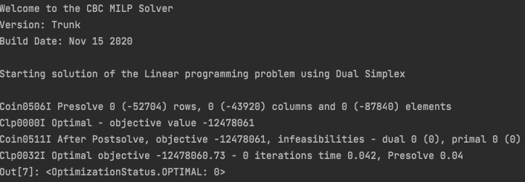
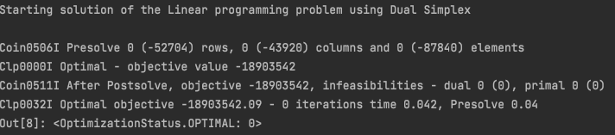
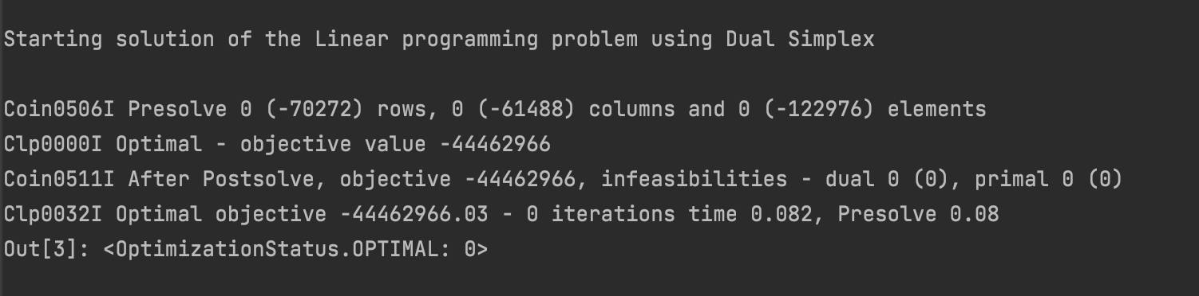
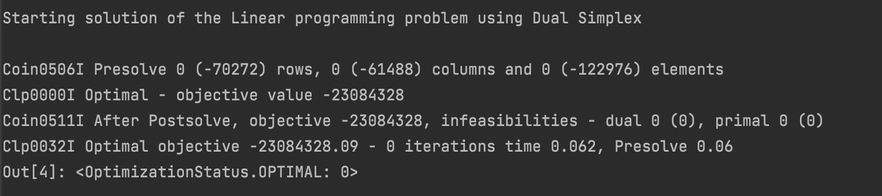
wholesale prices CHP
household prices CHP
wholesale prices CHP + boiler
household prices CHP + boiler

Slide 2
wholesale prices CHP
household prices CHP
wholesale prices CHP + boiler
household prices CHP + boiler

